Slide 1
Recipe Site Traffic Case Study
Hesham Ibrahim

Slide 2
Business Goals
To increase website traffic by displaying popular recipes on the homepage.
This leads to increase subscriptions which is essential for the business
To use data science to predict which recipes will lead to high traffic and correctly predict high traffic recipes 80% of the time.

Slide 3
Data Validation
Checked the data against the given description:
1- high_traffic has so many “nan” when the traffic is not high:
change “nan” to Low
2- category has an extra category 'Chicken Breast' which should be just 'Chicken':
change 'Chicken Breast' to 'Chicken'
3- servings is not Numeric as there are "as a snack" extra part in only 3 rows:
remove the substring
change to int type
4- there are 52 missing values in columns ['calories', 'carbohydrate', 'sugar', 'protein'] which represents 5.5% of the data set:
remove them after correcting high_traffic

Slide 4
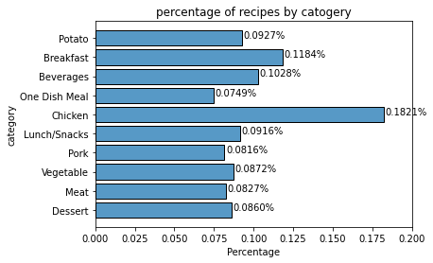
Data Visualization
The data shows that Chicken recipes are the most frequently posted followed by Breakfast.
One dish meals are the least frequently posted

Slide 5
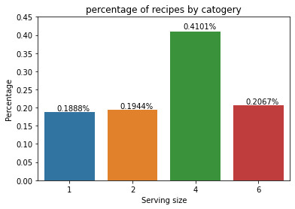
Data Visualization
The data shows 4 persons recipes are the most frequently posted
Single person recipes are the least frequently posted

Slide 6
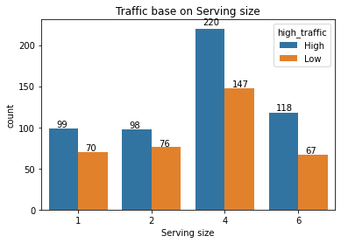
Data Visualization
The data shows 4 persons recipes has the highest number of generating traffic recipes
6 person recipes has high percentage of generating high traffic with 63.7% while 4 persons has 60%

Slide 7
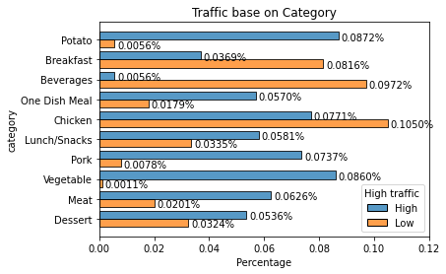
Data Visualization
Although chicken recipes are the most posted, they don’t generate the most traffic.
Potato and Vegetable recipes are the most popular ones
Beverages recipes are the least sough after recipes

Slide 8
Model Fitting
This is a classification problem: Binary classification (High, Low)
Since the data set is rather small; i.e, small number of features and instance, this allowed for a quick run though different models.
Testing: Logistic Regression, Support Vector Machines, Decision Trees, Random Forest, Naive Bayes, K-Nearest Neighbors classifiers.
Used Logistic Regression as baseline because:
Logistic Regression is robust to noise in the data, which makes it a good choice for our dataset.
It is computationally efficient and does not require a lot of data to train
it's widely used in industry
The logistic regression was not good enough with only 74% testing score.

Slide 9
Model Fitting
Using Random Forest:
Random Forest can handle high dimensional data, and it's also robust to correlated features.
Random Forest is robust to outliers.
Random Forest is computationally efficient and does not require a lot of data to train
The RF Model generated 73.2% testing score
Hyper Params tuning improved the score to 75.8%

Slide 10
Model Fitting
Using Gradient Boosting Classifier because:
GBM is an ensemble method that combines multiple weak models to create a strong one.
GBM is a flexible algorithm that can handle various types of data, including categorical, numerical and missing data.
GBM is widely used in industry, and has been applied to many real-world problems, making it a reliable and robust algorithm.
GBM started with 75% testing score
GBM hyper paraments tuning paired with best random state lead to 83% testing score.

Slide 11
Model Evaluation
the Random Forest out preform the Logistic Regression in both accuracy and recall
Random Forest optimization did not reach the requires prediction score
using Gradient boost classifier with optimization did achieve the min score request

Slide 12
Business Focus
The main focus of this study:
Get insights on the recipes posted and their impact on traffic
The majority of recipes are chicken recipes however they do not create the most traffic
Potato and Vegetable generates the most traffic
Beverages generated the least traffic
Serving size of 6 generates the most traffic 63% of the time posted
Serving size of 4 is the most posted however they only generate high traffic 60% of the posts.

Slide 13
Business Focus
The main focus of this study:
2. Create and train a model that predict high traffic recipes at least 80% of the time
Using Logistic Regression classifier as baseline model with 74% accuracy.
Using Random Forest classifier with hyper params tuning generated only 75.8% accuracy
Using Gradient boost classifier with hyper params tuning generated 83% accuracy.
Using accuracy as KPI to compare models to business:
The data shows the business has 59.8% accuracy
The models have a min accuracy of 75% and improved to 83%

Slide 14
Business recommendation
the business should implement the model since it can identify more than 80% of the high traffic generating recipes
it is always a good practice to retrain the model with more data to improve its performance, in addition to capturing any changes in the customers behavior

